Slide 1

The Aga Khan Hospital Dar es Salaam
Family Medicine - OPA Documentation Compliance for Q4 2022

Slide 2
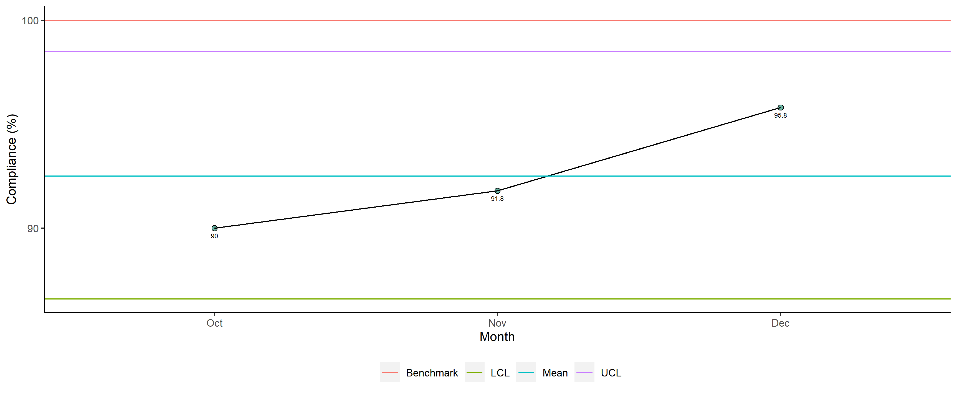
Family Medicine - Availability of Required Documents

Slide 3
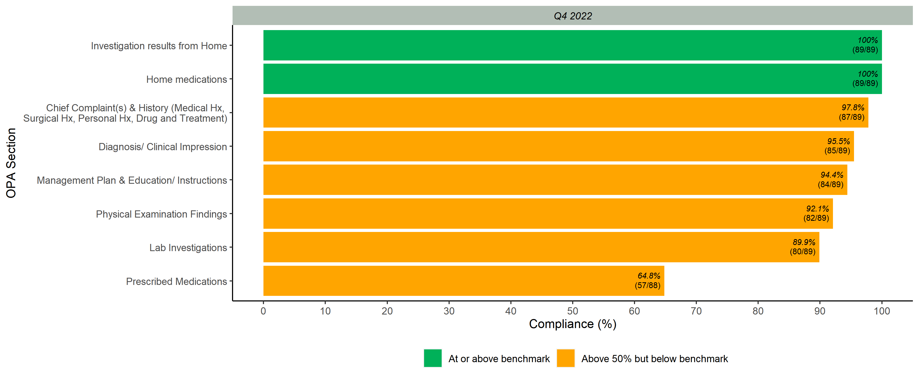
Documented Scores per OPA Section

Slide 4
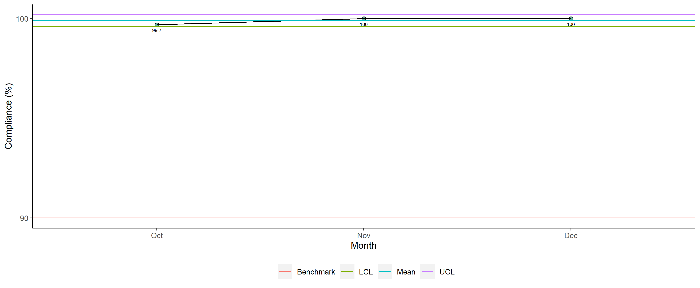
Family Medicine - Legibility

Slide 5
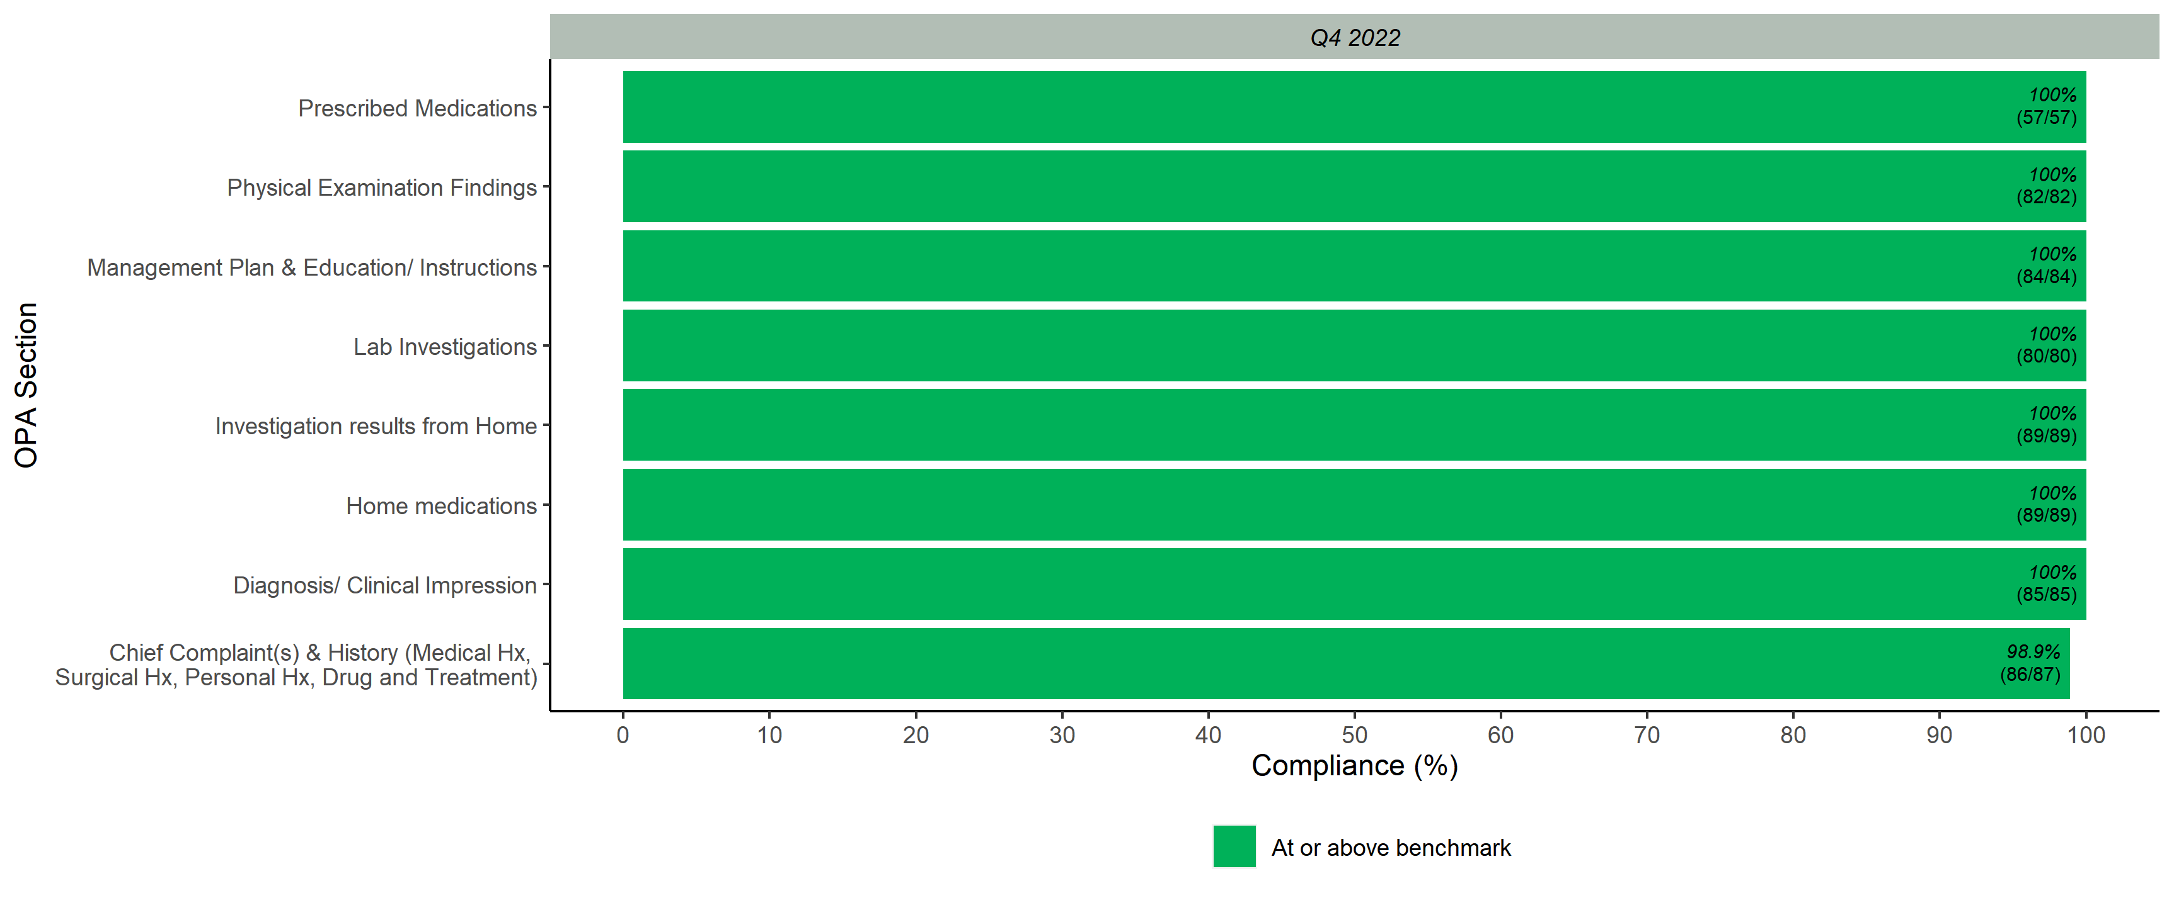
Legibility Scores per OPA Section

Slide 6
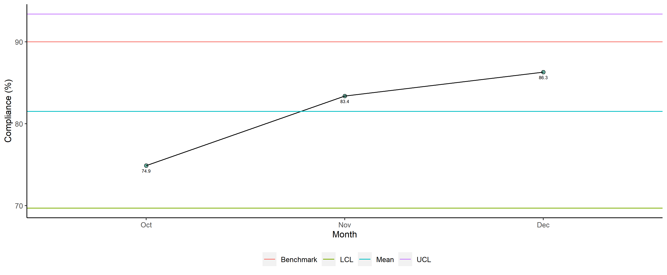
Family Medicine - Completeness

Slide 7
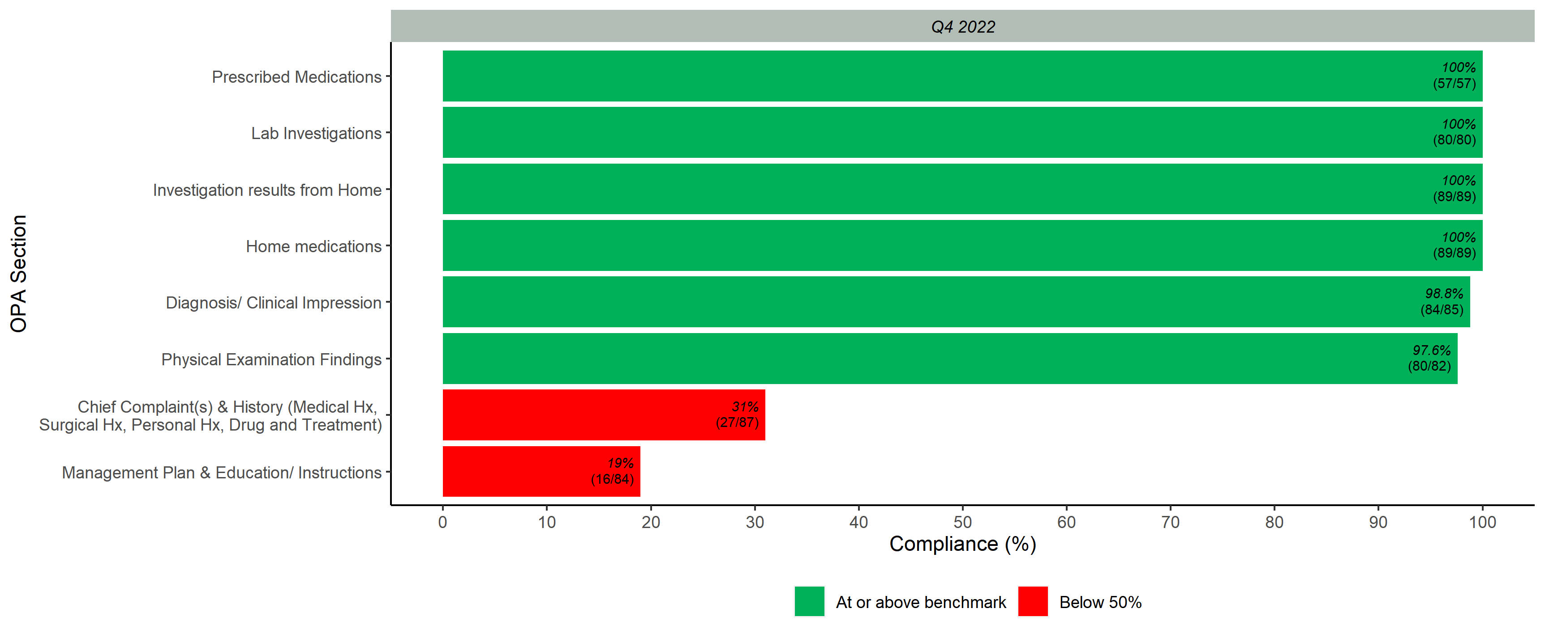
Completeness Scores per OPA Section

Slide 8
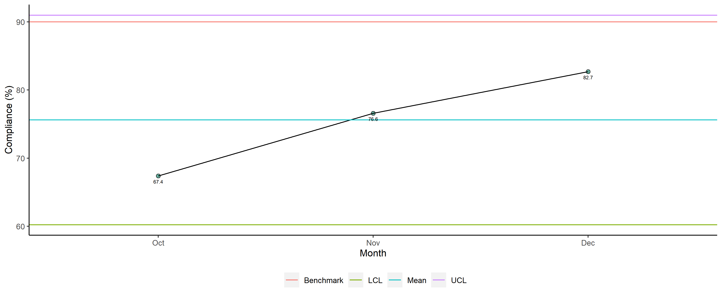
Family Medicine - Overall

Slide 9
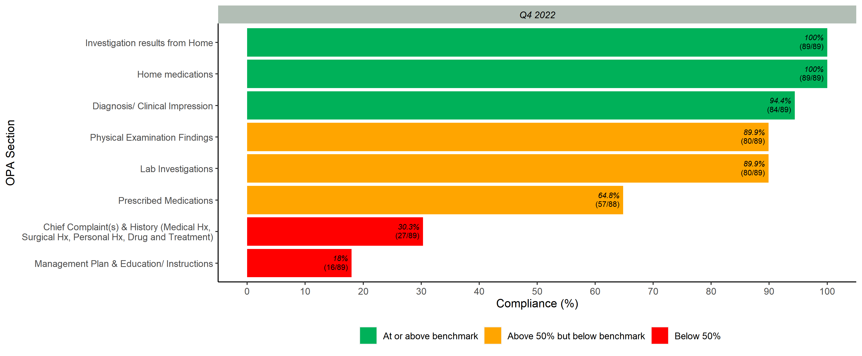
Overall Scores per OPA Section

